Slide 1
Virtual STEM Buddies
Shreya Ganeshan, Connor Gibbs, Rachel Zilinskas
STAT 5010 End of Semester Presentation

Slide 2

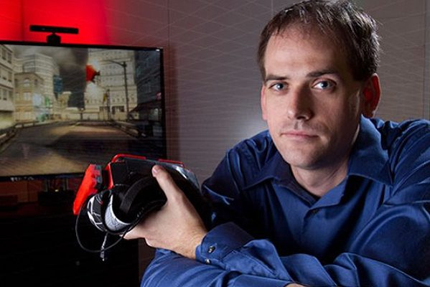
Introduction
Pilot in Children’s Museum of Atlanta
LeverHero and Slingshot
Project led by Dr. Kyle Johnsen (UGA Engineering), Dr. Sun Joo (Grace) Ahn (UGA Grady), and Catherine Ball (UGA Engineering)
Virtual STEM Buddy (VSB) — a visitor-tailored, virtually embodied agent
VSB engages with child-visitors and families in a social interface (Xbox Kinect games)
Learns/grows through expertise
Notes:
Shreya

Slide 3
Goals — High Level
Help make just-in-time connections to a child’s island of expertise
Provide ongoing, cumulative knowledge building around a child’s island of expertise
Improve interest in STEM disciplines among those traditionally underrepresented
Notes:
Shreya
Provide a social experience with each child
Help make just-in-time connections to a child’s island of expertise
Provide short explanations and directions for interaction with the exhibits

Slide 4
Data Files
File Name | Function
Daily File List | Keeps track of every file that was not automatically deleted
Interaction Event Log | Contains interaction start/end times, minigame start/end times, skeleton start/end times, new main skeleton indicator, and picture chosen
Minigame Log | Records minigame start/end times, problem start/end times, attempt start/end times, and slingshot attempts
Skeleton Log | Documents ID, distance from control, main skeleton indicator, time, and coordinates for hips, head, shoulders, elbows, wrists, hands, knees, and ankles.
Notes:
1st three - Shreya
Last 2 - Rachel

Slide 5
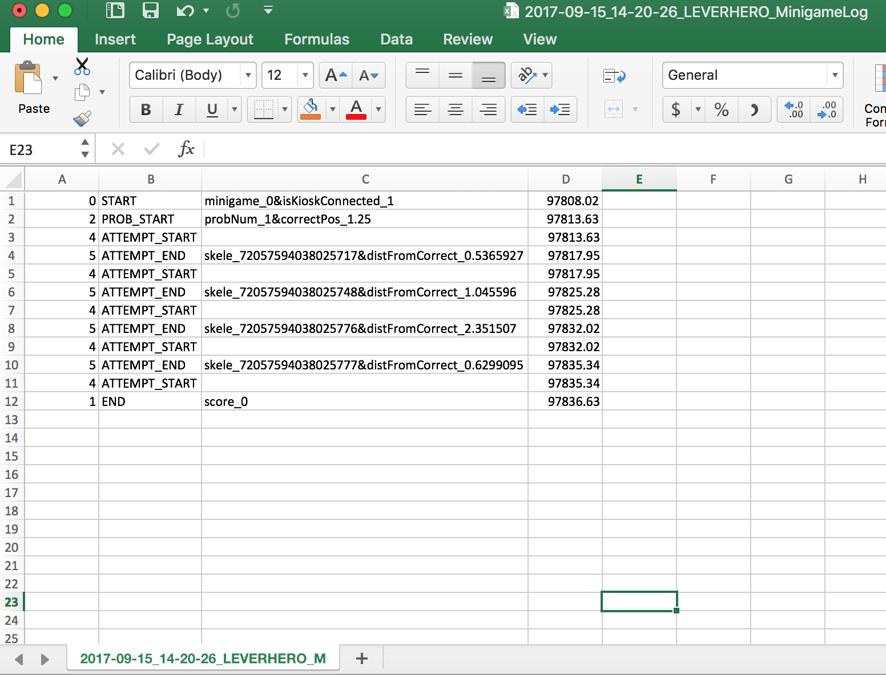
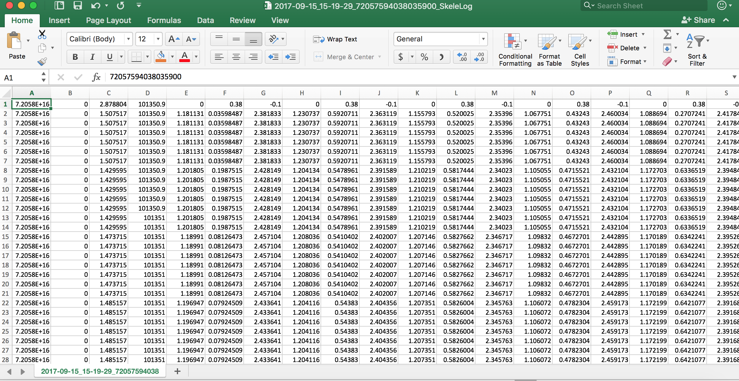
Data Description
6 months of data: June 2017 to November 2017
Recording process:
Skeleton appearance (depth camera)
Skeleton movement (Kinect)
Challenging elements:
Inconsistency and disorganization
Volume
Collected at 60 frames per second
1 week ~ 17 million rows
Non-interpretable units
Notes:
Rachel
Inconsistency in recording
I.e. flaws in the system (won’t record legs if you’re wearing black pants)
Lack of units
Change in variables recorded mid-way through process
Disorganization
Different logs recorded in different styles
Different files for each participant makes entering data into software more difficult
No variable headers - given only in data description with some rows missing/undefined
Lack of units - none recorded, when we checked with Catherine, she said she was unsure and would get back to us
Volume of data - so large that it could not fit into 2GB flash drives at initial meeting
Kinect records 60 frames per second
Over 17 million rows per week

Slide 6
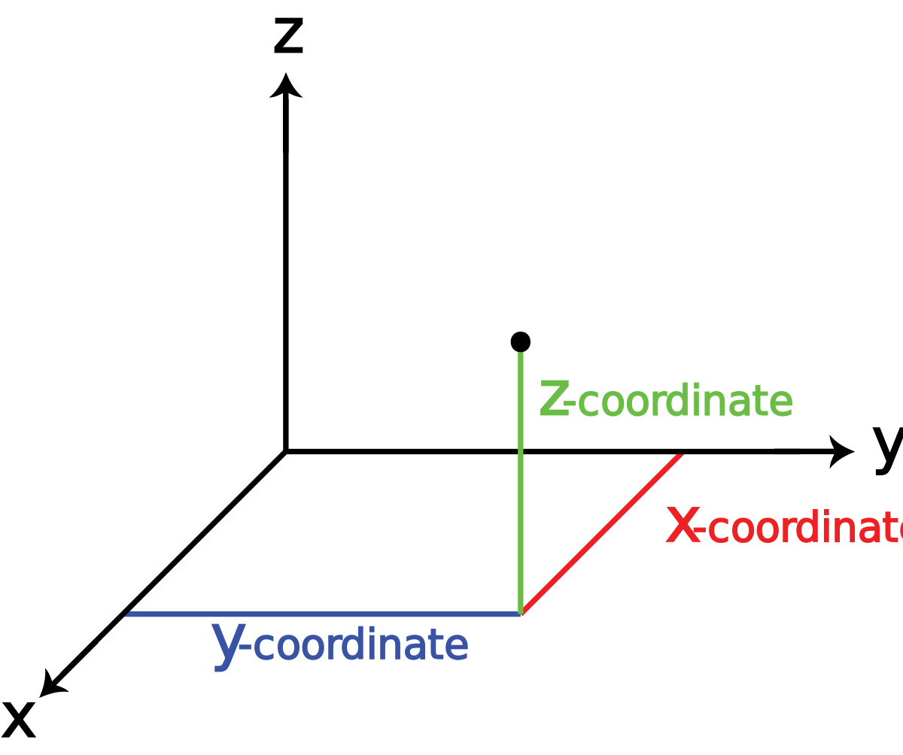
Goals — Low Level
Transform skeleton data:
Capture players’ characteristics
Height, outstretched hands, shoulder width, arm length, etc.
Summarize players’ movements
Forward/backward, left/right, up/down, etc.
Normalize starting point
Identify player interacting with game
Notes:
Rachel

Slide 7

Vectorized Skeleton
(xi, yi, zi)
Notes:
Connor
17 points
3 axes
51 time series

Slide 8
Exploratory Data Analysis:
Skeleton Characteristics
Frequency and density plots based on 200 random participations from 9/10-9/16/17
Height
Outstretched hands
Shoulder Width
Right Arm Length
Units presumed to be feet
Assumptions inconsistent with definitions
Other variables of interest:
Main skeleton indicator
Distance in (x, y, z) directions relative to control point
“Normalizing starting point”
Elapsed time and success in game
Notes:
Connor
Height - defined as maximum distance between head and left ankle
Outstretched hands - defined as maximum distance between right and left hands
Shoulder width - defined as maximum distance between left and right shoulders
Right arm length - defined as maximum distance between right shoulder and right hand

Slide 9
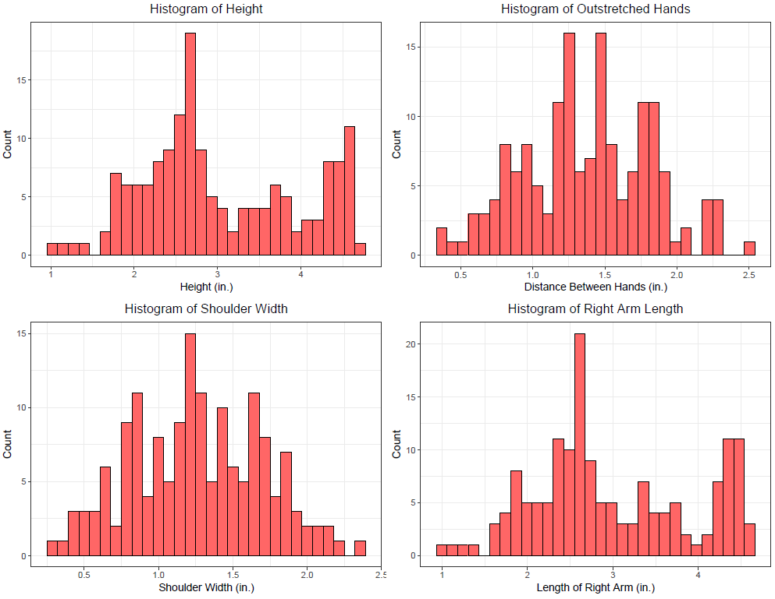
Notes:
Connor, Shreya, Rachel

Slide 10
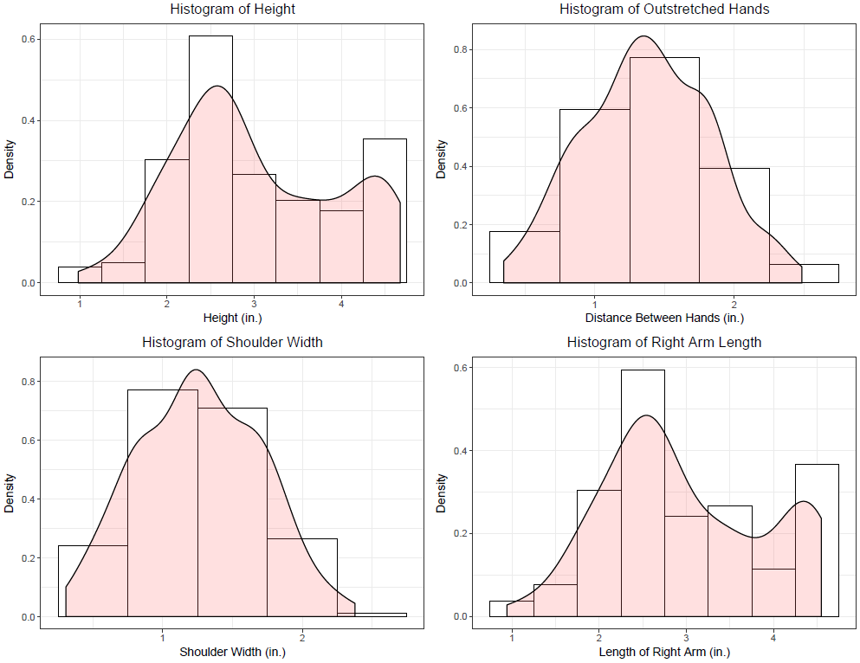
Notes:
Connor, Shreya, Rachel
Talk about how children and adults are both interacting with the game, but for this project, we only want to look at children.
Density plots of height/length of right arm are bimodal -- there are children and adult players currently.
We could subset the data to only include children.
Would expect to see bimodality in shoulder width, but don’t see it right away.
Next steps: check of those that are taller, are they the main skeletons?

Slide 11
Future Research Plan
Examining main skeleton indicator relative to distribution of variables
Defining metric for game success
Identifying factors predictive of success
Adapting minigame based on model’s predictive success
Notes:
Connor, Rachel, Shreya
Relative Success (ratio of score:time) → see if there is a relationship between any of our indicators and relative success
Machine learning - make the game harder for those historically successful

